Slide 1
Flight of the FINCH through the Java Wilderness
Braden Licastro
Matthew Hajduk
Marco Corona
Ian McMillian

Slide 2
FINCH
Evolves Java Bytecode
Uses Compatible Crossover
Used to solve:
Simple/Complex Regression
Trail Navigation
Image Classification
Array Sum
Tic-Tac-Toe

Slide 3
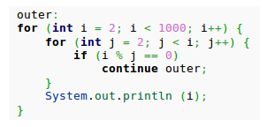
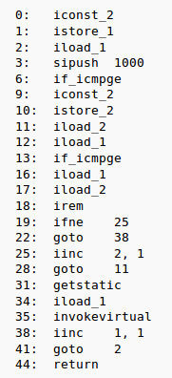
Byte Code
Working with bytecode prevents non-compilable source code.
Fitness difficult as incorrect programs cannot run
Type mismatches primary cause of failure
Can handle non halting programs
No loss of compiler optimization

Slide 4
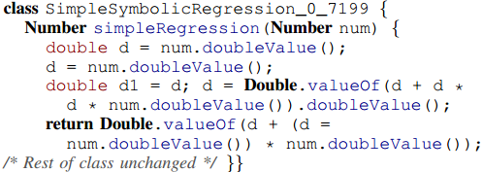
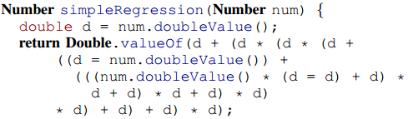

Symbolic Regression:
Simple and Complex
Results
-Classic GP test case
-Scores fitness on single numeric equation(right)
-DEVTAG Evolutionary Algorithm
Equation:
x^4 + x^3 + x^2 + x
Notes:
In order to support their hypothesis, the author applies FINCH to a selection of problems.
The authors chose to start with the Simple Symbolic Regression test case. This is a classic test case where candidates with a single numeric input are scored on how they are able to solve an equation. This is performed on 20 random samples,
Population: 500
Crossover Probability: 0.9
Mutation: None
Binary Tournament Selection
See upper screenshot for result example, there was an ideal individual found in every run
Complex:
Used DEVTAG - employs multi-stage comparison between individuals to compute fitness
Population: 500
Crossover Probability: 0.9
Mutation: None
Tournament Selection with size 7
Ideal individual found in every run.

Slide 5
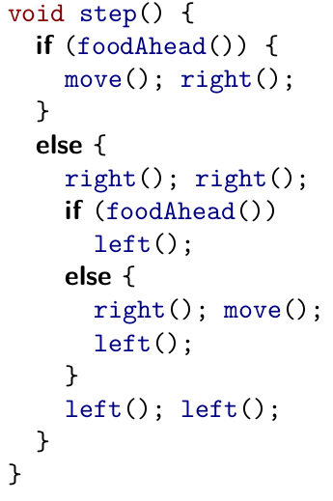
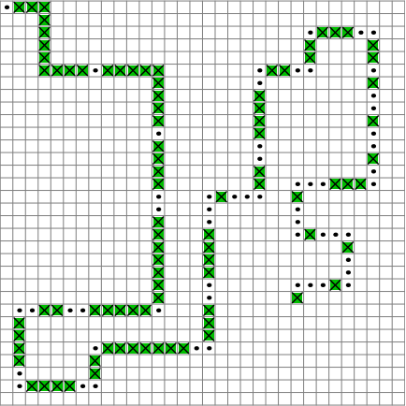

Artificial Ant
Results
Emulates an Ant navigating an irregular trail containing 89 food pellets.
Population: 500
Crossover: 0.9
Mutation: none
Tournament Size: 7
Operations:
MOVE - Moves ant in direction it currently faces
LEFT - Rotate left 90 degrees
RIGHT - Rotate right 90 degrees
Notes:
Ant Navigate an irregular trail containing 89 food pellets.
Operations:
MOVE - Moves ant in direction it currently faces
LEFT - Rotate left 90 degrees
RIGHT - Rotate right 90 degrees
Population: 500
Crossover: 0.9
Mutation: None
Tournament Size: 7

Slide 6
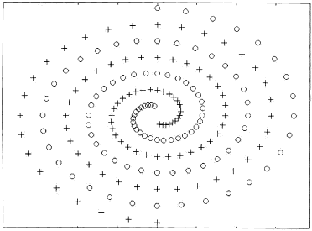
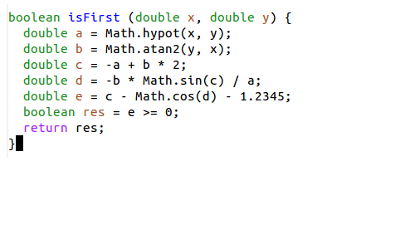
Intertwined Spirals
Results
best-of run individuals

Slide 7
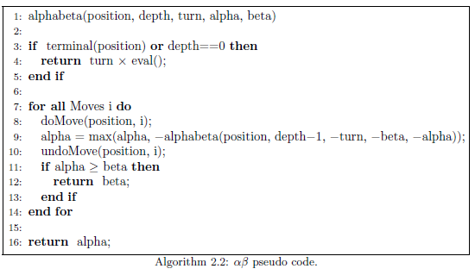
Array Sum & Tic-Tac-Toe
Results
Evalution of Individuals
Loops and Recursion

Slide 8
Limitations Future Work
Requires a good fitness function
You may want a stricter crossover requirement
Apply FINCH to additional problems
Handling more advanced code structures
Develop an IDE

Slide 9
Questions/Comments..??
licastb@allegheny.edu
hajdukm2@allegheny.edu
coronam@allegheny.edu
macmili@allegheny.edu

